Slide 1
Advanced Python Programming for Emerging Applications

Slide 2
COURSE OBJECTIVES
To develop skills in file handling and exception handling.
To build applications for automating tasks.
To build web scraping applications.
To create applications for data analysis and visualization.

Slide 3
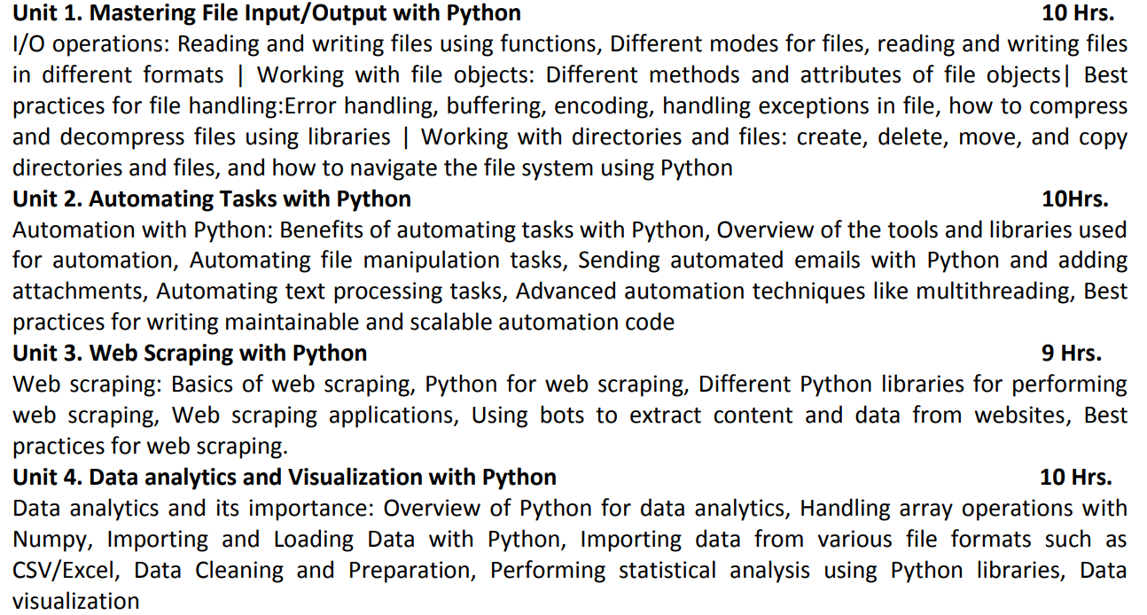

Slide 4
COURSE OUTCOMES
CO 1: Implement Python programs using fundamental programming concepts.
CO 2: Develop skills in file handling and exception handling in Python.
CO 3: Build automated applications.
CO 4: Build web scraping applications and bots.
CO 5: Design Python programs for performing data analysis and data visualization.
CO 6: Develop Python applications for real-world problems.

Slide 5


Slide 6
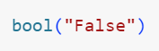
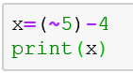
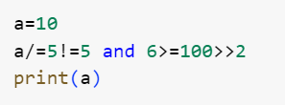
Let’s Recall Basic Python

Slide 7
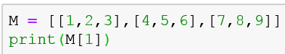
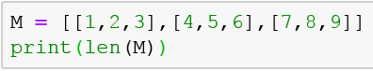

Slide 8
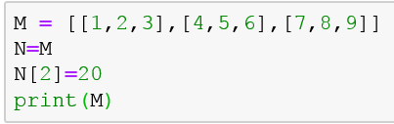
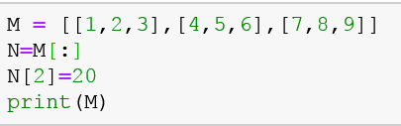

Slide 9
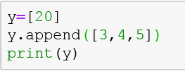
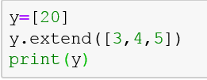

Slide 10
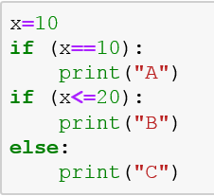
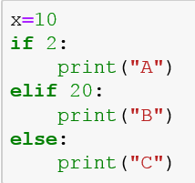
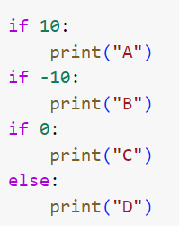
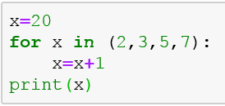

Slide 11
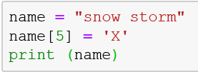
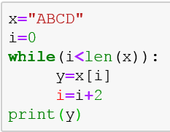
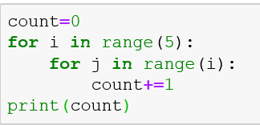

Slide 12
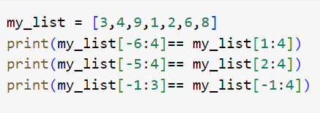
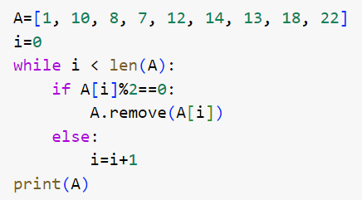

Slide 13
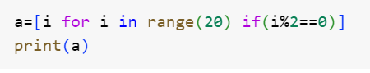

Slide 14
File Handling

Slide 15
What is File?
File is a named location on disk to store related information. It is used to permanently store data in a non-volatile memory

Slide 16
Operation in File
Open a file
Read or write (perform operation)
Close the file

Slide 17
Open a file
File_pointer = open(<file_name/path>, <access_mode>)

Slide 18
File mode
1 | r Opens a file for reading only. The file pointer is placed at the beginning of the file. This is the default mode.
2 | rb Opens a file for reading only in binary format. The file pointer is placed at the beginning of the file. This is the default mode.
3 | r+ Opens a file for both reading and writing. The file pointer placed at the beginning of the file.
4 | w Opens a file for writing only. Overwrites the file if the file exists. If the file does not exist, creates a new file for writing.
5 | w+ Opens a file for both writing and reading. Overwrites the existing file if the file exists. If the file does not exist, creates a new file for reading and writing.
6 | a Opens a file for appending. The file pointer is at the end of the file if the file exists. That is, the file is in the append mode. If the file does not exist, it creates a new file for writing.
7 | a+ Opens a file for both appending and reading. The file pointer is at the end of the file if the file exists. The file opens in the append mode. If the file does not exist, it creates a new file for reading and writing.

Slide 19
Reading from file
filehandle.txt
Hello! Welcome to filehandle.txt
Reading the file is very easy.
Now you can read a file from your hard disk
Good Luck!
fp = open(" filehandle.txt", "r")
print(fp.read())
print(fp.read(5))
print(fp.readline())
fp.close()

Slide 20
Write into file
with open("test.txt",'w') as fp:
fp.write("my first file\n")
fp.write("This file\n\n")
fp.write("contains three lines\n")
fp.close()
fp = open("test.txt",'w') fp.write("my first file\n")
fp.write("This file\n\n")
fp.write("contains three lines\n")
fp.close()

Slide 21
Append in file
fp = open("test.txt",’a’)
fp.write("my first file\n")
fp.write("This file\n\n")
fp.write("contains three lines\n")
fp.close()

Slide 22
Few important function
fp.seek(0)
fp.tell()

Slide 23
Problem
Write a program to copy contain of file X.txt to Y.txt
fpx=open('hello.txt','r')
fpy=open('new.txt','w+')
for line in fpx:
fpy.write(line)
fpy.seek(0)
print(fpy.read())
fpx.close()
fpy.close()
# Method 1
f1 = open("X.txt", "r")
f2 = open("Y.txt", "w")
f2.write(f1.read())
f1.close()
f2.close()
# Method 2
f1 = open("X.txt", "r")
f2 = open("Y.txt", "w")
for line in f1.readlines():
f2.write(line)
f1.close()
f2.close()
# Method 3
f1 = open("X.txt", "r")
f2 = open("Y.txt", "w")
for line in f1:
f2.write(line)
f1.close()
f2.close()

Slide 24
Write a code to read file and give you summary of the file.
Number of words
Number of character (with space)
Number of character (without space)
Frequency of character
Number of paragraph

Slide 25
Solution
count_character = 0
count_word = 1
count_space = 0
count_line = 1 frequency_character = {}
f1 = open("file.txt", "r")
data = f1.read()
for x in data:
if x == ' ':
count_space += 1
count_character += 1
count_word += 1
elif x == '\n':
count_word += 1
count_line += 1
else:
count_character += 1
if x in frequency_character:
frequency_character[x] += 1
if x not in frequency_character:
frequency_character[x] = 1
print("Words: ", count_word)
print("Characters with spaces: ", count_character)
print("Characters without spaces: ", count_character-count_space)
print("Spaces: ", count_space)
print("Lines: ", count_line)
f1.close()

Slide 26

Lecture 4-5 CSV, Lamda function, Map, Reduce

Slide 27
Example
You are given a CSV file named "student_grades.csv," which contains the following data:
Name | Maths | Science | English
John | 85 | 78 | 92
Alice | 89 | 90 | 93
Bob | 76 | 90 | 85
Eve | 88 | 78 | 88

Slide 28
Your task is to write a Python program that reads this CSV file, calculates the average score for each student, and then creates a new CSV file named "student_average_grades.csv”
Steps to Solve
Read the data from "student_grades.csv" using CSV file handling in Python.
For each student, calculate their average score across all subjects (Maths, Science, and English).
Create average functions to calculate the average for each student.
Store the student's name and their corresponding average score in a new dictionary.
Write the data from the dictionary into a new CSV file named "student_average_grades.csv" with two columns: "Name" and "Average."

Slide 29
import csv
input_file = "student_grades.csv"
output_file = "student_average_grades.csv"
student_grades = {}
# Read data from CSV file
with open(input_file, "r") as csvfile:
reader = csv.DictReader(csvfile)
for row in reader:
name = row["Name"]
math_score = int(row["Maths"])
science_score = int(row["Science"])
english_score = int(row["English"])
score=[math_score, science_score, english_score]
average_score = sum(score) / len(scores)
student_grades[name] = average_score

Slide 30
# Write data to new CSV file
with open(output_file, "w", newline="") as csvfile:
fieldnames = ["Name", "Average"]
writer = csv.DictWriter(csvfile, fieldnames=fieldnames)
writer.writeheader()
for name, average in student_grades.items():
writer.writerow({"Name": name, "Average": average})
print("Successfully calculated and saved average grades in 'student_average_grades.csv'.")

Slide 31
Use pandas to solve this problem

Slide 32
import pandas as pd # Function to calculate average using lambda function
calculate_average = lambda scores: sum(scores) / len(scores) def main():
input_file = "student_grades.csv" # Read data from CSV file using pandas
df = pd.read_csv(input_file) # Calculate average for each student and add "Average" column
df["Average"] = df.apply(lambda row: calculate_average([row["Maths"], row["Science"], row["English"]]), axis=1)

Slide 33
# Write data back to the input CSV file with "Average" column
df.to_csv(input_file, index=False)
print("Successfully calculated and appended average grades as a new column in 'student_grades.csv'.")
if __name__ == "__main__":
main()

Slide 34
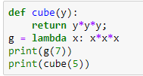
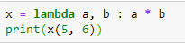
Lambda Function
lambda arguments: expression

Slide 35
Lambda function
Anonymous and don't require a formal function definition with def
Readability: For small and straightforward operations, using a lambda function
Short-lived functions: n can make the code more readable and self-contained.

Slide 36
Problem
I have a list which contains temperature in Celsius. Task is to convert Celcius to faherenheit.
i/p- [39.2, 45.5,67.9,38.3]
o/p- corresponding faherenheit

Slide 37
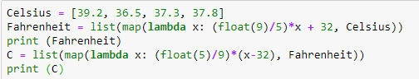
map

Slide 38
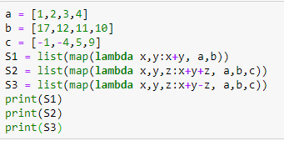

Slide 39
Problem
I am exploring company data. I want to filter out data which is currently in list form. Rule for filtration – if number is odd then accept it put into an odd list else reject it and put into an even list.

Slide 40
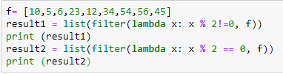
Filter

Slide 41
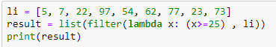

Slide 42
Problem-
In a company I am doing some task where I have to find sum of squares of the given list.
I/p- [2,3,6,5]
o/p- 2*2 +3*3 + 6*6 + 5*5 = 74

Slide 43
Reduce
from functools import reduce
li=[1,2,3,4,5,6,7]
sum= reduce((lambda x,y:x*x+y*y),li)
print(sum)

Slide 44
from functools import reduce
f=lambda a,b: a if(a>b) else b
r = reduce(f, [47,111,42,102,13])
print(r)

Slide 45
Problem Statement
You are working as a data engineer for a large retail company. Your team is responsible for processing and analyzing sales data from multiple stores across the country. The sales data is stored in CSV files, and each file represents sales data for a specific month and year. Each CSV file has the following columns:
Date (in the format "YYYY-MM-DD")
Store ID (a unique alphanumeric code)
Product ID (a unique alphanumeric code)
Quantity sold (an integer representing the number of products sold on that date)
The "product_names.csv" file has two columns: "Product ID" and "Product Name," and it contains the mapping for all products in the sales data.

Slide 46
Your task is to write a Python program that performs the following operations:
Read the sales data from all the CSV files in a given directory and its subdirectories.
Calculate the total sales (quantity sold) for each product across all stores and all months.
Determine the top 5 best-selling products in terms of the total quantity sold.
Create a new CSV file named "sales_summary.csv" and write the following information into it:
Product ID
Product Name
Total Quantity Sold
Average Quantity Sold per month (considering all months available in the data)

Slide 47
JSON(JavaScript Object Notation) File Handling

Slide 48
Team’s Code
uddfmzr

Slide 49
JSON file structure
{"employees":[
{"name":"Sunny", "email":”sunny@gmail.com"},
{"name":"Rahul", "email":"rahul32@gmail.com"},
{"name":"John", "email":"john32bob@gmail.com"}
]}
JSON stands for JavaScript Object Notation.
JSON is lightweight data-interchange format.
JSON is language independent.
JSON supports array, object, string, number and values.

Slide 50
JSON Data types
Data Type | Description | Example
String | A string is always written in double-quotes. It may consist of numbers, alphanumeric and special characters. | "student", "name", "1234", "Ver_1"
Number | Number represents the numeric characters. | 121, 899
Boolean | It can be either True or False. | true
Null | It is an empty value.

Slide 51
JSON object
JSON objects refer to dictionaries, which are enclosed in curly brackets, i.e., { }.
{"name" : "Jack", "employeeid" : 001, "present" : false}
{
"employee": {
"name": "sonoo",
"salary": 56000,
"married": true
}
}

Slide 52
JSON Array
[{
"PizzaName" : "Country Feast",
"Base" : "Cheese burst",
"Toppings" : ["Jalepenos", "Black Olives", "Cherry tomatoes"],
"Spicy" : "yes",
},
{
"PizzaName" : "Veggie Paradise",
"Base" : "Thin crust",
"Toppings" : ["Jalepenos", "Black Olives", "Cherry tomatoes"],
"Spicy" : "yes",
}
]

Slide 53
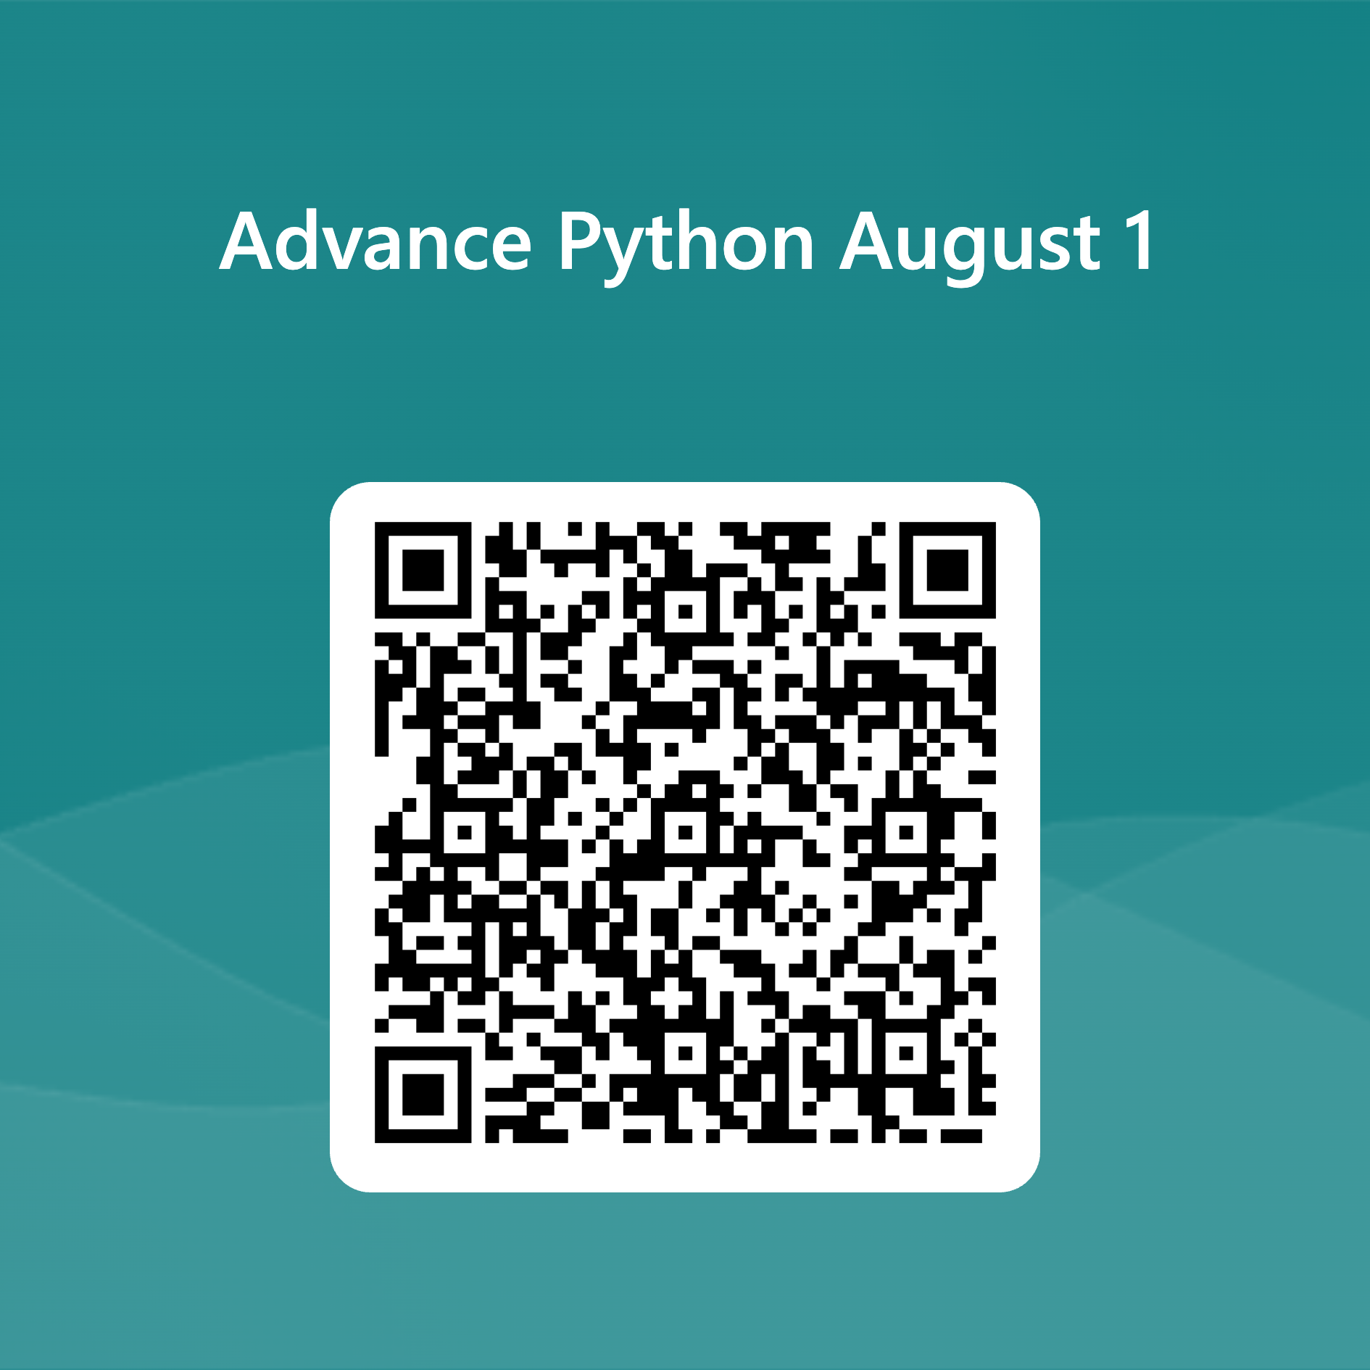
Attendance

Slide 54
Reading JSON File
import json
# Sample JSON data in "data.json"
# {"name": "John Doe", "age": 30, "city": "New York"}
file_path = "data.json"
# Reading JSON data from the file
with open(file_path, "r") as json_file:
data = json.load(json_file)
print(data)
# Output: {'name': 'John Doe', 'age': 30, 'city': 'New York'}

Slide 55
Writing JSON file
import json # Sample Python dictionary
data = {
"name": "John Doe",
"age": 30,
"city": "New York"
}
# Writing JSON data to a file
file_path = "output.json"
with open(file_path, "w") as json_file:
json.dump(data, json_file)
# The "output.json" file will contain: {"name": "John Doe", "age": 30, "city": "New York"}

Slide 56
Problem Statement
You are working as a data scientist for a healthcare organization, and your team has been tasked with analyzing COVID-19 data from multiple countries. The data is stored in JSON files, with each file representing the daily COVID-19 statistics for a specific country. Each JSON file has the following structure:
{ "country": "Country Name",
"date": "YYYY-MM-DD",
"confirmed_cases": { "total": 1000, "new": 50 },
"deaths": { "total": 20, "new": 2 },
"recovered": { "total": 800, "new": 30 }
}

Slide 57
Loading JSON Data as Python Objects:
import json # Sample JSON data in "nested_data.json"
# {"person": {"name": "John Doe", "age": 30}, "city": "New York"}
file_path = "nested_data.json" # Reading JSON data from the file
with open(file_path, "r") as json_file:
data = json.load(json_file)
print(data)
# Output: {'person': {'name': 'John Doe', 'age': 30}, 'city': 'New York'}
print(data['person']['name'])
# Output: 'John Doe'

Slide 58
Your task is to write a Python program that performs the following operations:
Read COVID-19 data from all JSON files in a given directory and its subdirectories.
Calculate and display the following statistics for each country:
Total confirmed cases.
Total deaths.
Total recovered cases.
Total active cases (total confirmed cases minus total deaths and total recovered).
Determine the top 5 countries with the highest number of confirmed cases and the lowest number of confirmed cases.
Generate a summary report in JSON format that includes the statistics for all countries and save it to a file named "covid19_summary.json".

Slide 59
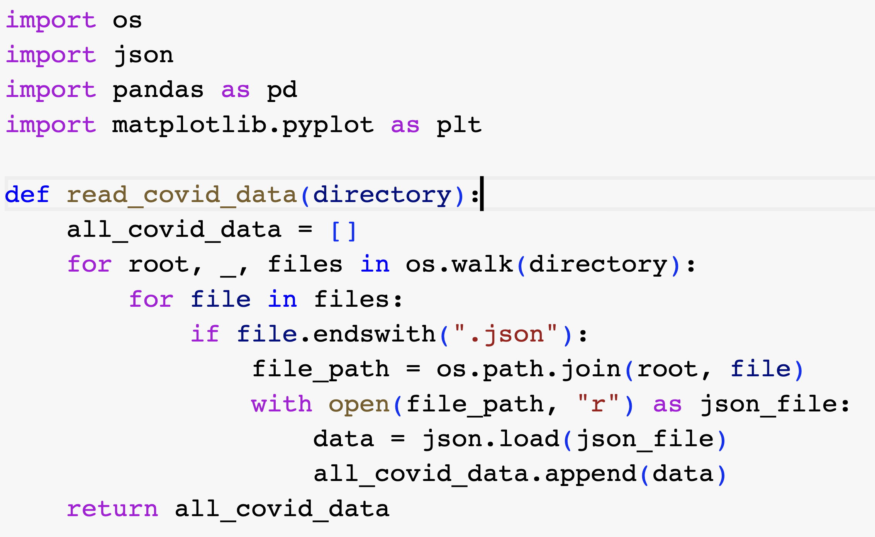

Slide 60
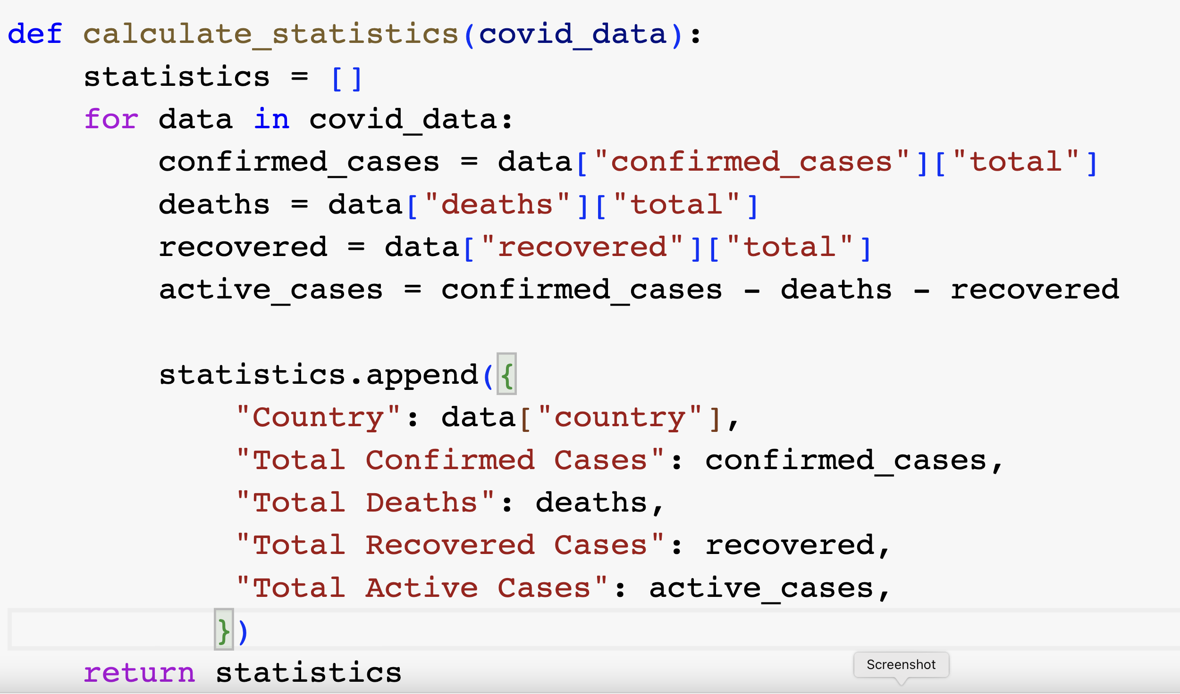

Slide 61
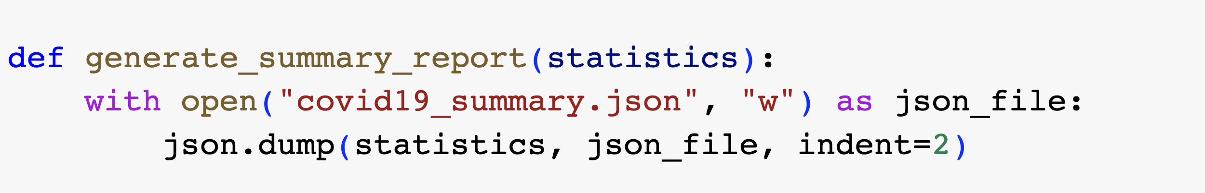

Slide 62
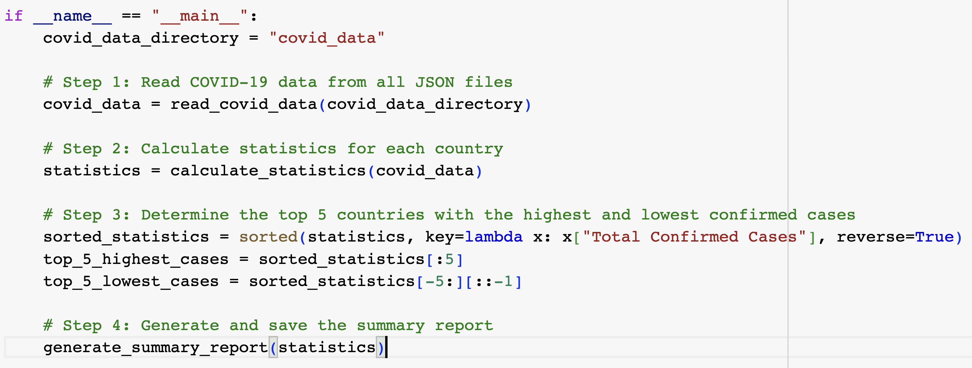

Slide 63
Exception Handling

Slide 64
Exceptions
Exceptions are unforeseen errors or problems that can occur during the execution of a Python program.
These errors can cause the program to terminate abruptly if not handled properly. Python provides a robust mechanism called "exception handling" to manage such errors gracefully.
ZeroDivisionError,
TypeError,
ValueError,
IOError,
IndexError,
KeyError,
NameError"

Slide 65
Example of Exception
102/0
Open(xyz.txt). //xyz.txt not present in the folder
Int(“Hello”)
date_str = "2023-07-32"
date_obj = datetime.strptime(date_str, "%Y-%m-%d")
ZeroDivisionError
IOError
TypeError
ValueError

Slide 66
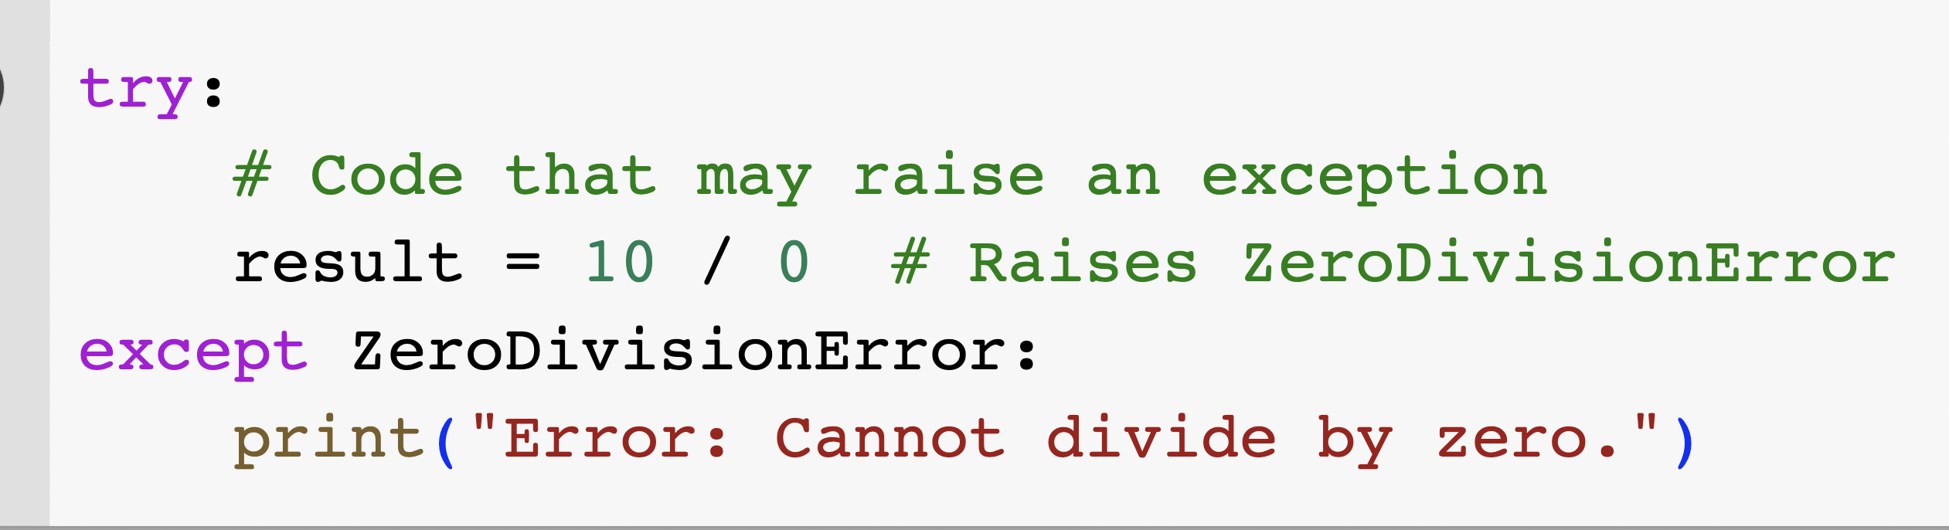
Handling Exception

Slide 67
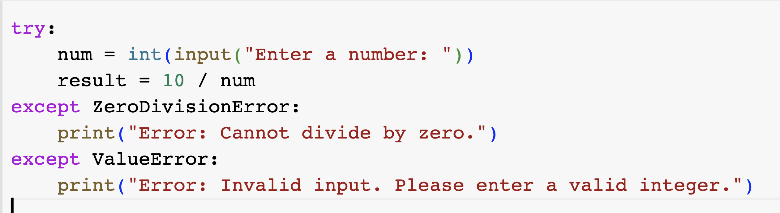
Multiple error possibility

Slide 68
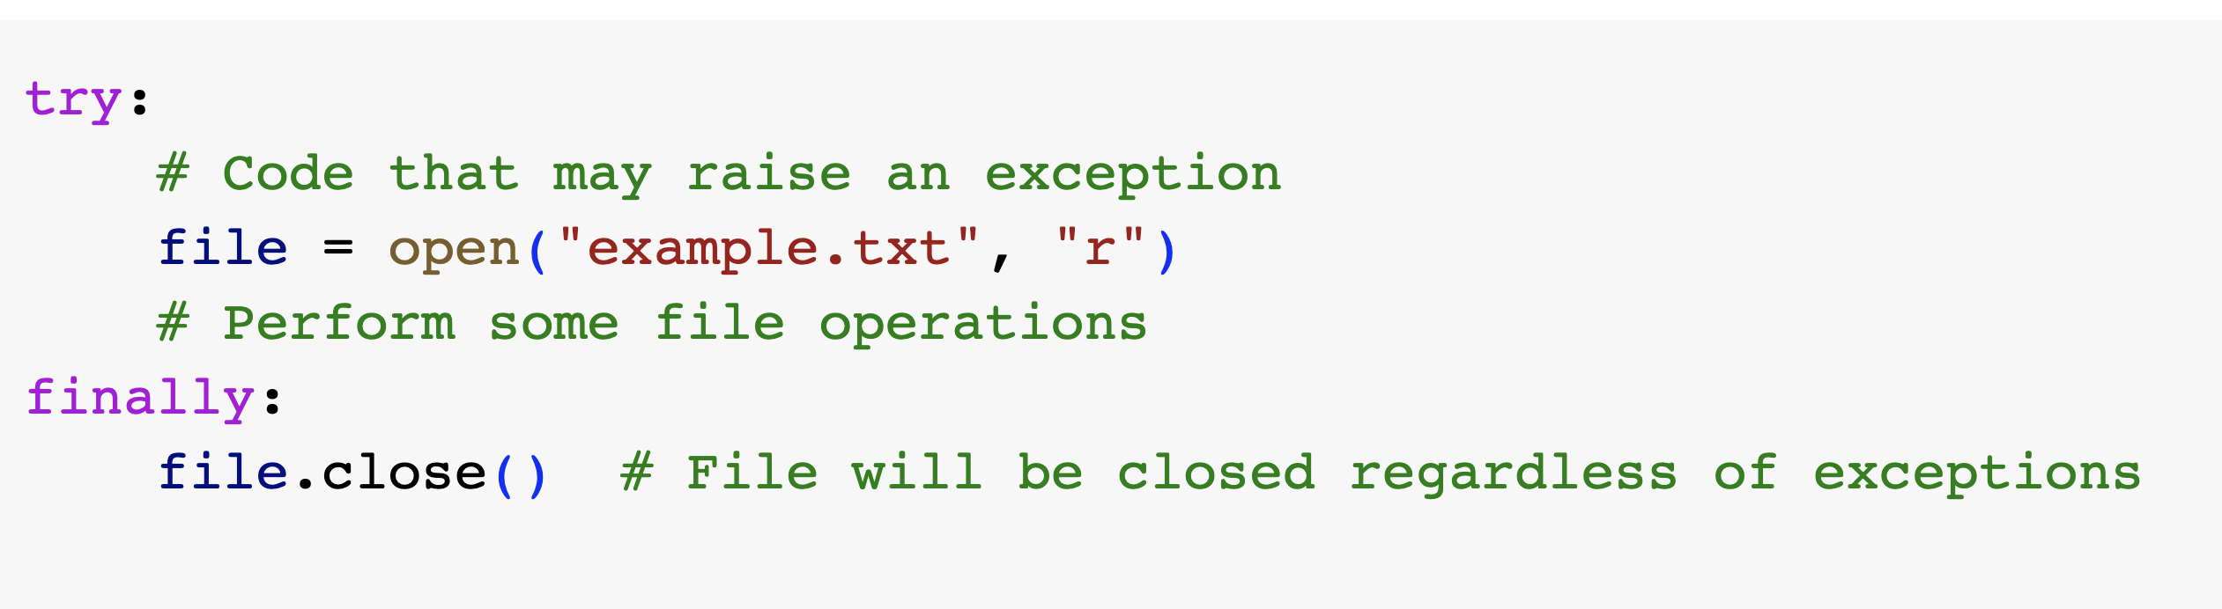
Finally: Something that must execute
The finally block, if present, will always be executed, whether an exception occurs or not.
It is used for cleanup operations like closing files or releasing resources.

Slide 69
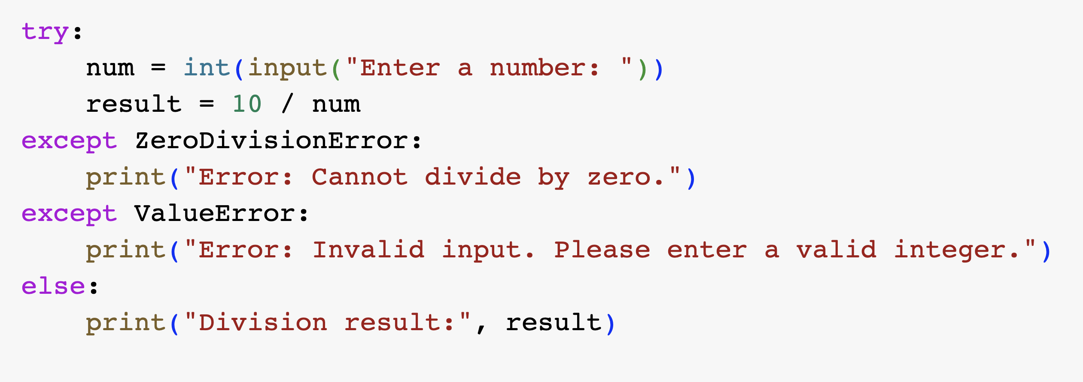
Else clause
The else clause is executed if no exceptions occur inside the try block.
It is typically used to specify code that should be executed when the try block runs without any exceptions.

Slide 70
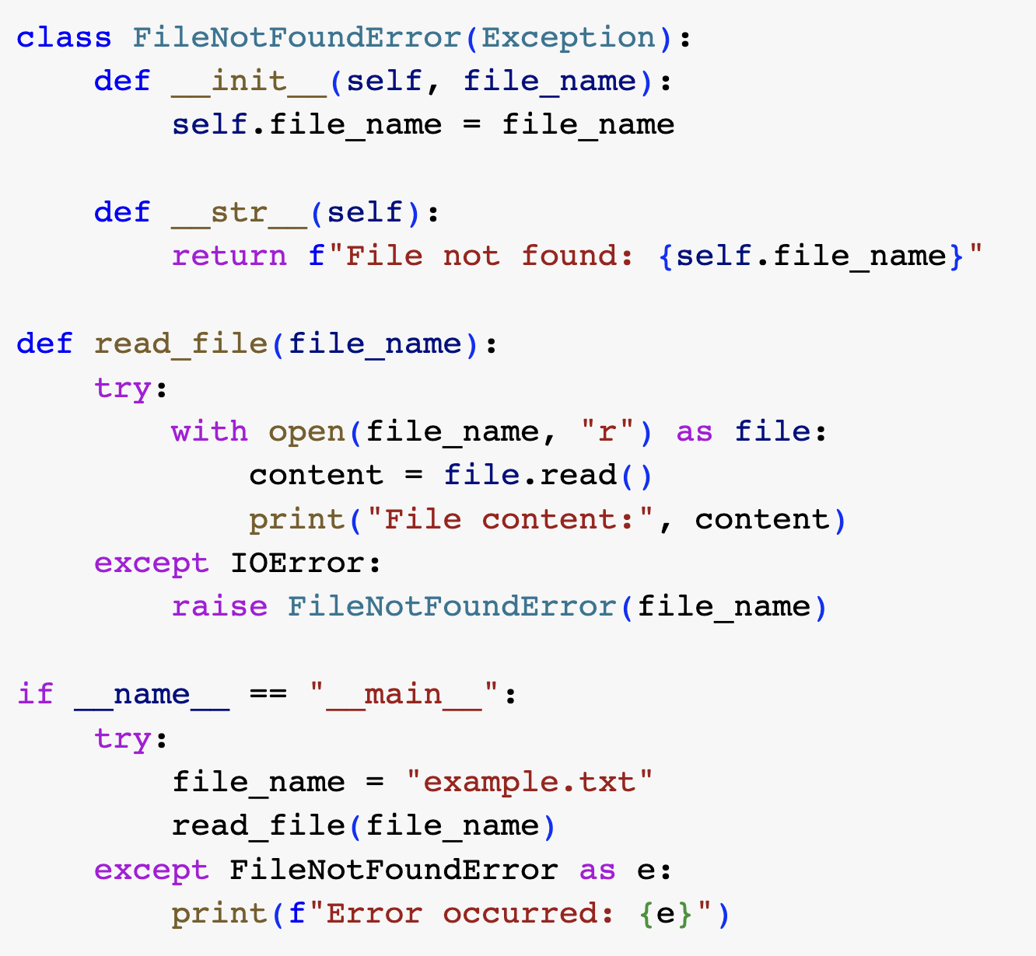
Custom Exception:

Slide 71
Types of Exception
ZeroDivisionError,
TypeError,
ValueError,
IOError,
IndexError,
KeyError,
NameError

Slide 72
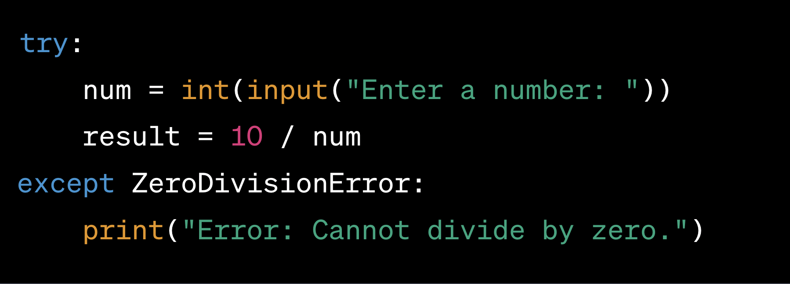
Find Exception type
num = int(input("Enter a number: "))
result = 10 / num

Slide 73
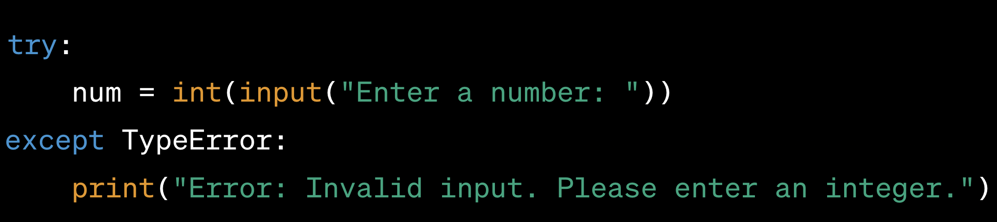
num = int(input("Enter a number: "))

Slide 74
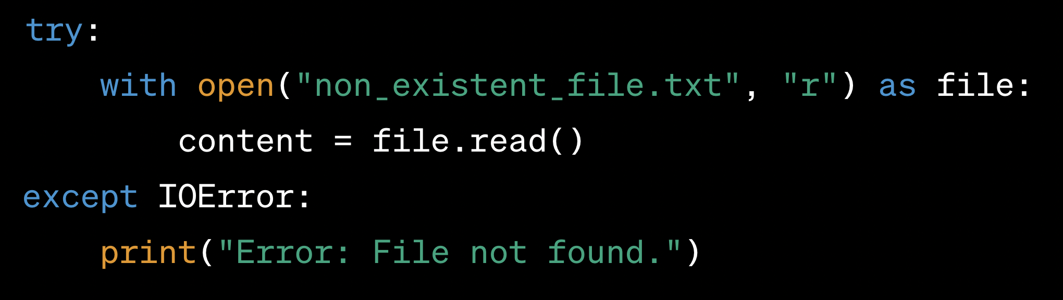
with open("non_existent_file.txt", "r") as file: content = file.read()

Slide 75
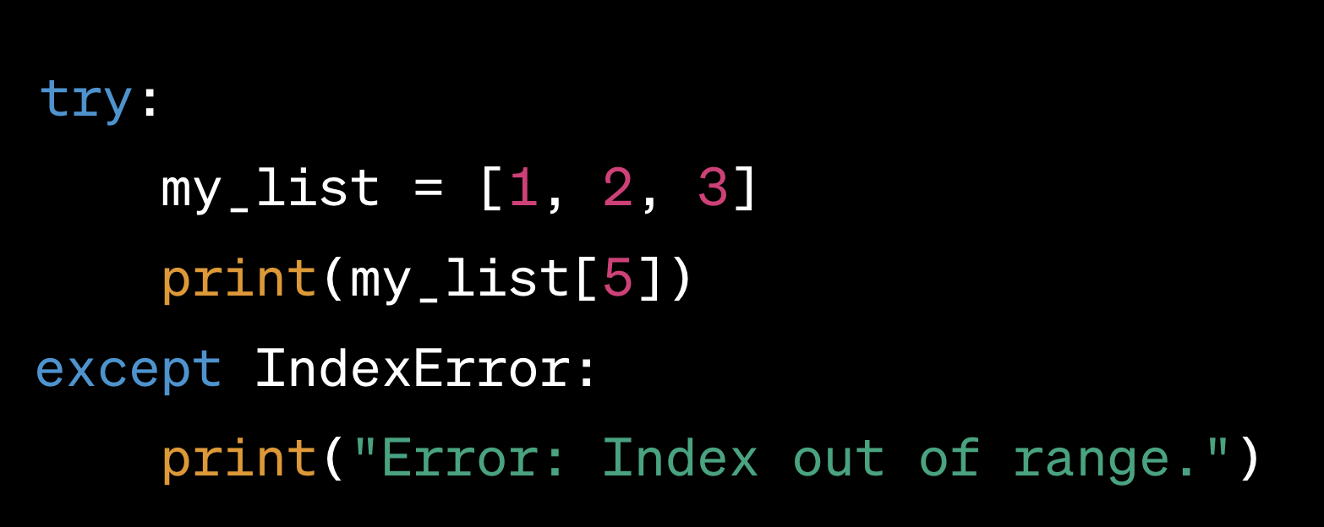
my_list = [1, 2, 3] print(my_list[5])

Slide 76
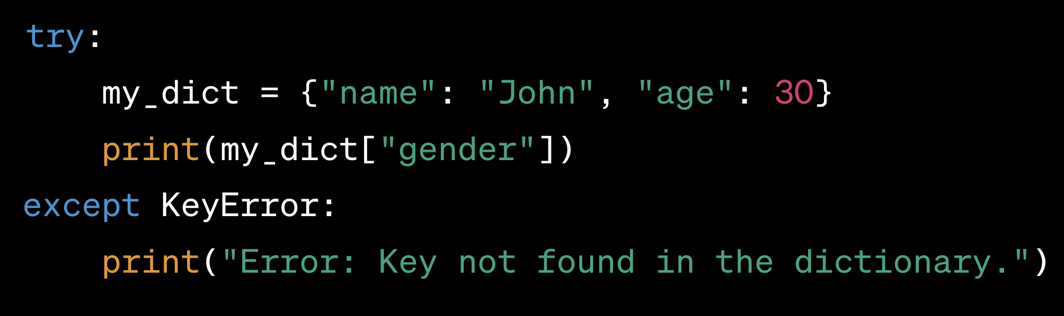
my_dict = {"name": "John", "age": 30} print(my_dict["gender"])

Slide 77
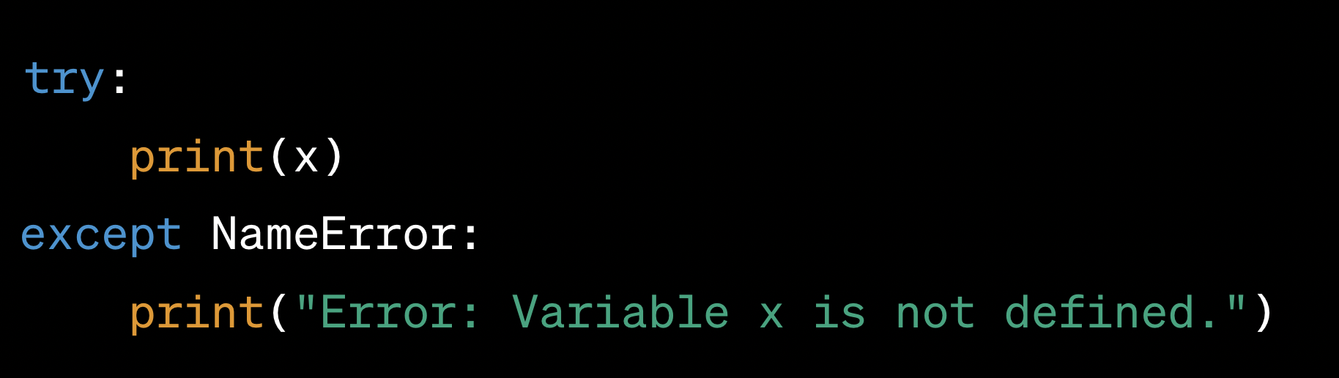
print(x) //x is not defined previously

Slide 78
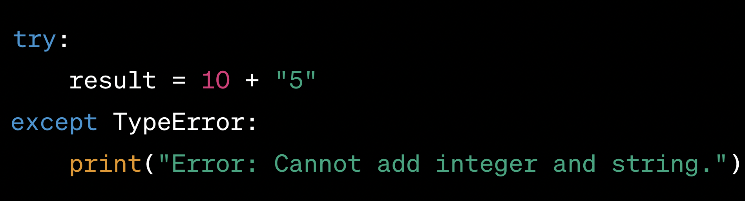
result = 10 + "5"

Slide 79
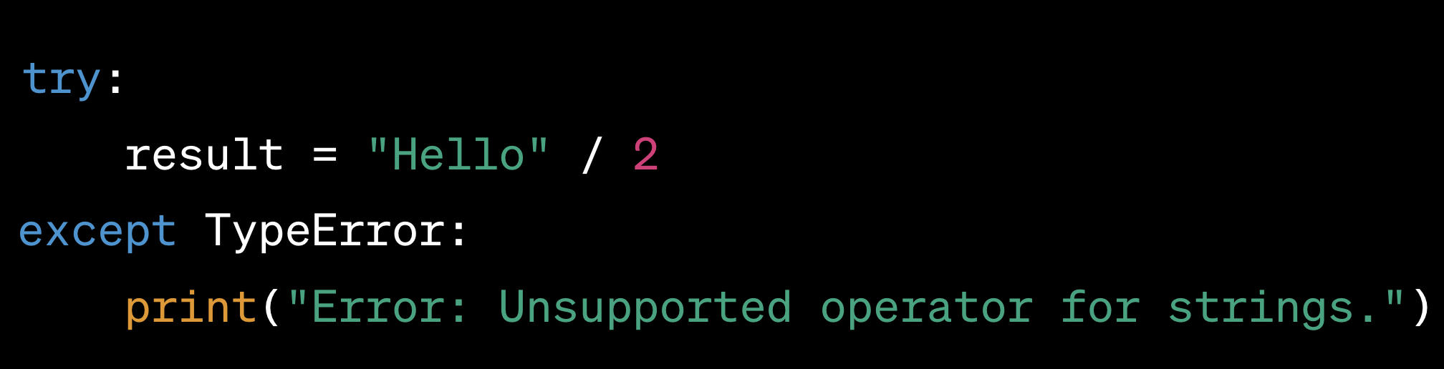
result = "Hello" / 2

Slide 80
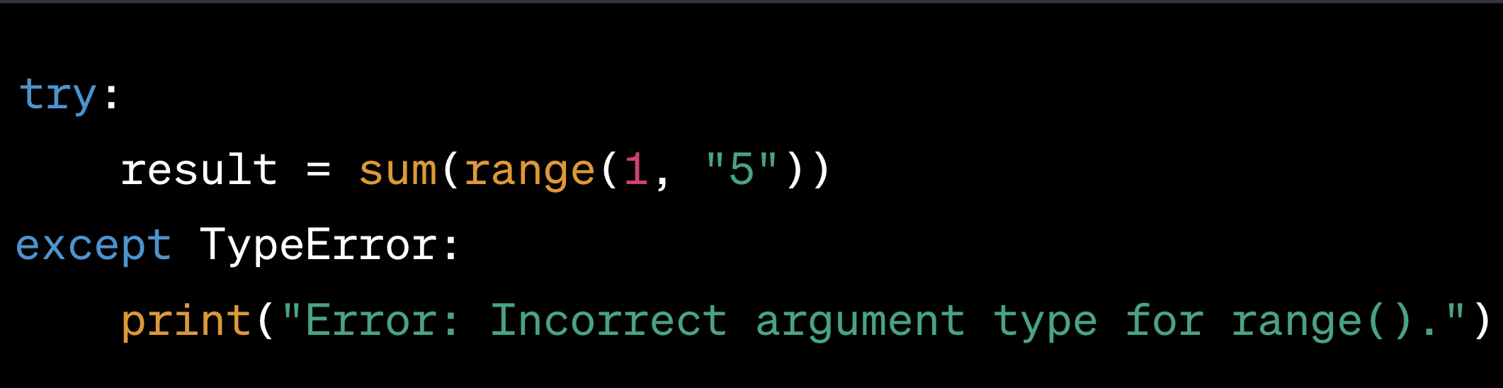
result = sum(range(1, "5")

Slide 81
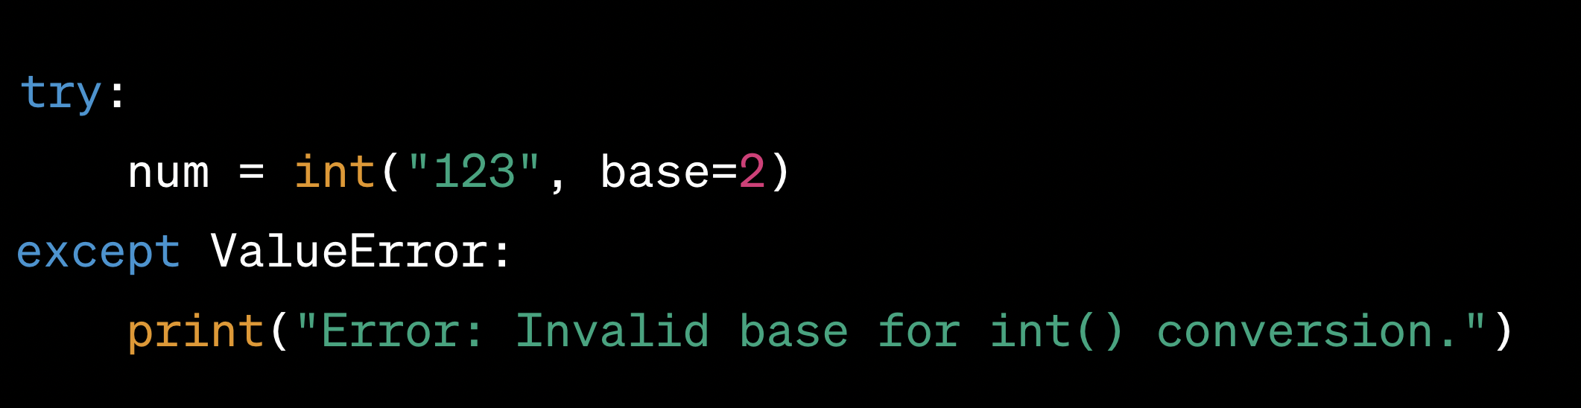
num = int("123", base=2)

Slide 82
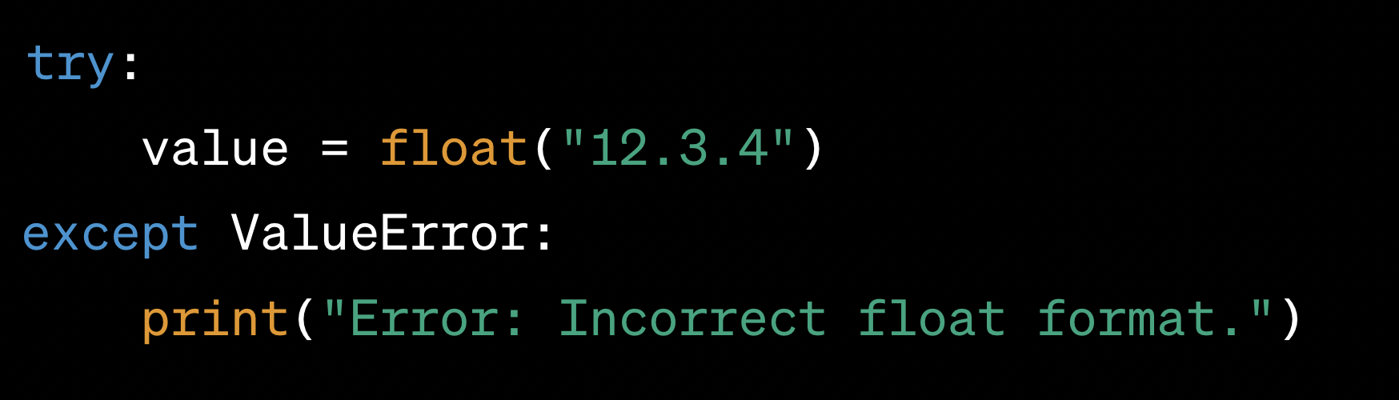
value = float("12.3.4")

Slide 83
Problem
You are working on a project to build a custom text processing tool that reads input from various sources, processes the text data, and stores the results in an output file. As part of this project, you need to implement a robust exception handling mechanism to handle potential errors that may arise during the text processing.
The tool needs to perform the following steps:
Read the input data from a file specified by the user.
Process the text data by performing various operations, such as counting words, calculating character frequencies, and generating word clouds.
Store the processed results in an output file.

Slide 84
Task
Your task is to design a Python program that incorporates appropriate exception handling to handle the following situations:
File Not Found Error: If the user provides an invalid file path or the input file is not found, your program should raise a custom exception FileNotFoundError with a suitable error message.
Invalid Input Data: During text processing, if any unexpected input data is encountered (e.g., non-string values or missing data), your program should raise a custom exception InvalidInputDataError with relevant details.
Disk Space Full: If the output file cannot be written due to insufficient disk space, your program should raise a custom exception DiskSpaceFullError

Slide 85
Additionally
You can use Python's built-in modules, such as os for file handling and logging for logging exceptions
The program should have the following features:
The custom exception classes should inherit from the base Exception class and provide meaningful error messages.
Proper logging should be implemented to capture details about the exceptions that occur during text processing.
The program should provide a user-friendly interface, allowing the user to enter the input file path and choose the desired text processing operations.
The processed results should be stored in an output file with a suitable format (e.g., JSON, CSV, or plain text).

Slide 86
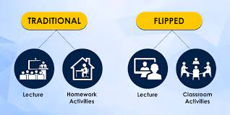
Lecture 9
File Compression

Slide 87
Task no = (Project team’s smallest rollno) mod 5
Task 0= gzip library
Task 1= bz2 library
Task 2 = lzma library
Task 3= zipfile library
Task 4 = tarfile library
Submission- Ipython Notebook (ipynb) contains following-
Team member’s detail (Name, Enrollment, Python group)
Tutorial on respective library (Code and detail description of the code)
Filename- <Task no - Task name – Team member name>
Deadline- End of today’s lecture

Slide 88
Logging

Slide 89
What is Logging
Logging is a means of tracking events that happen when some software runs.
The software’s developer adds logging calls to their code to indicate that certain events have occurred.
An event is described by a descriptive message which can optionally contain variable data.

Slide 90
Convenience Function
debug(), info(), warning(), error() and critical().
Task you want to perform | The best tool for the task
Display console output for ordinary usage of a command line script or program | print()
Report events that occur during normal operation of a program (e.g. for status monitoring or fault investigation) | logging.info() (or logging.debug() for very detailed output for diagnostic purposes)

Slide 91
Task you want to perform | The best tool for the task
Issue a warning regarding a particular runtime event | warnings.warn() in library code if the issue is avoidable and the client application should be modified to eliminate the warning logging.warning() if there is nothing the client application can do about the situation, but the event should still be noted
Report an error regarding a particular runtime event | Raise an exception
Report suppression of an error without raising an exception (e.g. error handler in a long-running server process) | logging.error(), logging.exception() or logging.critical() as appropriate for the specific error and application domain

Slide 92
Level or severity of the events
Level | When it’s used
DEBUG | Detailed information, typically of interest only when diagnosing problems.
INFO | Confirmation that things are working as expected.
WARNING | An indication that something unexpected happened, or indicative of some problem in the near future (e.g. ‘disk space low’). The software is still working as expected.
ERROR | Due to a more serious problem, the software has not been able to perform some function.
CRITICAL | A serious error, indicating that the program itself may be unable to continue running.

Slide 93
Example
import logging
logging.warning('Watch out!') # will print a message to the console
logging.info('I told you so') # will not print anything
Output:
WARNING:root:Watch out!

Slide 94
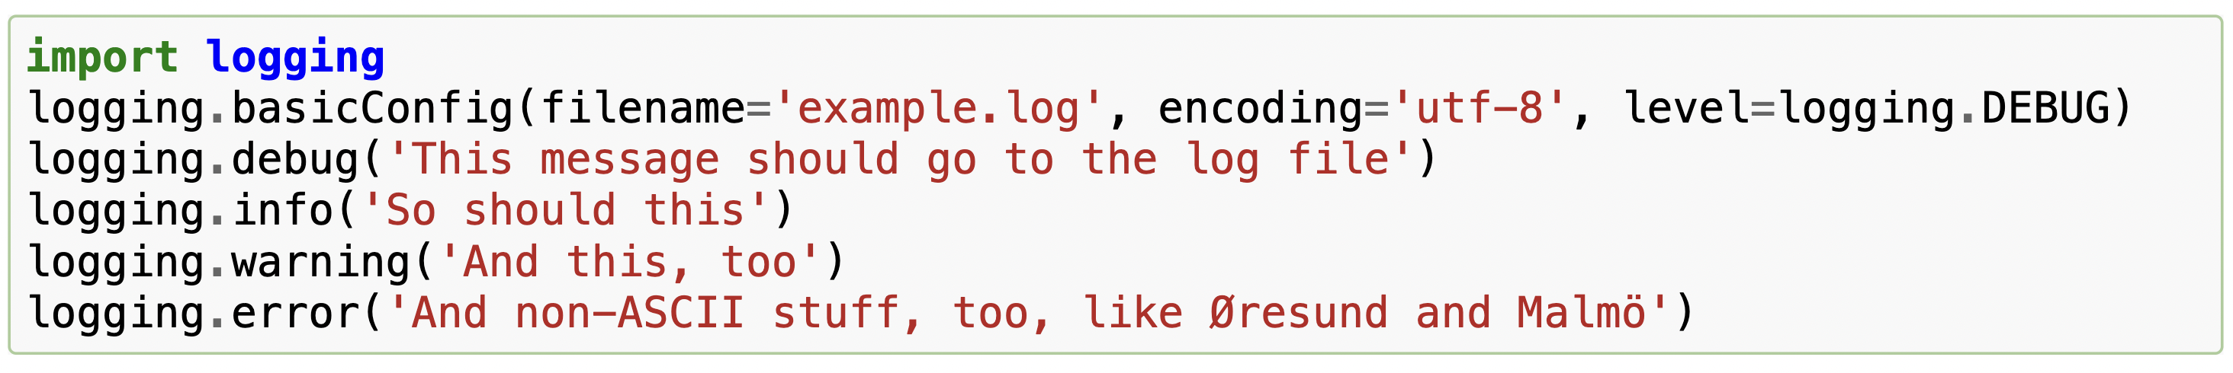
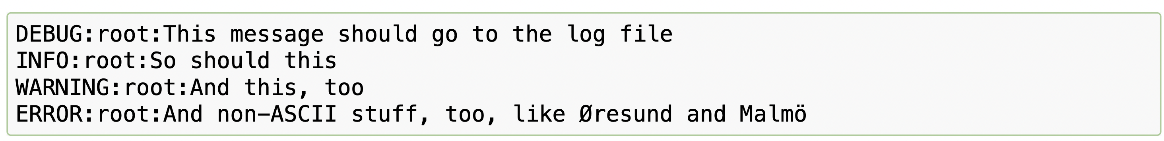
Logging to a file

Slide 95


Example

Slide 96


Changing the format of displayed messages

Slide 97


Date and time

Slide 98


Date and time specific format

Slide 99
Task to do
You are developing a command-line task management system for a small team of users. The system should allow users to create tasks, assign them, update statuses, and track deadlines. Instead of using a database, you decide to store task data in text files.
User Management:
Implement a user registration system where users can sign up and log in. Store user data in a file, including usernames and hashed passwords.

Slide 100


Slide 101


Slide 102


Slide 103


Slide 104


Slide 105
How logging works
The logging library takes a modular approach and offers several categories of components: loggers, handlers, filters, and formatters.
Loggers expose the interface that application code directly uses.
Handlers send the log records (created by loggers) to the appropriate destination.
Filters provide a finer grained facility for determining which log records to output.
Formatters specify the layout of log records in the final output.

Slide 106
Loggers
Logger objects have a threefold job.
First, they expose several methods to application code so that applications can log messages at runtime.
Second, logger objects determine which log messages to act upon based upon severity or filter objects.
Third, logger objects pass along relevant log messages to all interested log handlers.

Slide 107


Slide 108
logger
logger objects fall into two categories
configuration
message sending.

Slide 109
Configuration
Logger.setLevel() specifies the lowest-severity log message a logger will handle.
Where debug is the lowest built-in severity level and critical is the highest built-in severity.

Slide 110
Configuration
Logger.addHandler() and Logger.removeHandler() add and remove handler objects from the logger object. Handlers are covered in more detail in Handlers.
Logger.addFilter() and Logger.removeFilter() add and remove filter objects from the logger object. Filters are covered in more detail in Filter Objects.

Slide 111
Methods create log messages
Logger.debug(),
Logger.info(),
Logger.warning(),
Logger.error(),
Logger.critical() .

Slide 112
Log Message
Logger.exception() creates a log message similar to Logger.error().
The difference is that Logger.exception() dumps a stack trace along with it. Call this method only from an exception handler.
Creating custom log level
Logger.log() takes a log level as an explicit argument.

Slide 113
Logging Levels
Level | Numeric value
CRITICAL | 50
ERROR | 40
WARNING | 30
INFO | 20
DEBUG | 10
NOTSET | 0
These are primarily of interest if you want to define your own levels and need them to have specific values relative to the predefined levels.
If you define a level with the same numeric value, it overwrites the predefined value; the predefined name is lost.
it is possibly a very bad idea to define custom levels if you are developing a library. That’s because if multiple library authors all define their own custom levels, there is a chance that the logging output from such multiple libraries used together will be difficult for the using developer to control and/or interpret, because a given numeric value might mean different things for different libraries.

Slide 114
Handlers
Handler objects are responsible for dispatching the appropriate log messages (based on the log messages’ severity) to the handler’s specified destination.
As an example scenario, an application may want to send all log messages to a log file, all log messages of error or higher to stdout, and all messages of critical to an email address. This scenario requires three individual handlers where each handler is responsible for sending messages of a specific severity to a specific location.

Slide 115
Subprocess

Slide 116
Subprocess
The subprocess is a standard Python module designed to start new processes from within a Python script.
run multiple processes in parallel or call an external program or external command from inside your Python code
the subprocess module is that it allows the user to manage the inputs, the outputs, and even the errors raised by the child process from the Python code.

Slide 117
Subprocess.run
subprocess.run(args, *, stdin=None, input=None, stdout=None, stderr=None, capture_output=False, shell=False, cwd=None, timeout=None, check=False, encoding=None, errors=None, text=None, env=None, universal_newlines=None, **other_popen_kwargs)

Slide 118

Using subprocess.run()
The run function of the subprocess module in Python is a great way to run commands in the background without worrying about opening a new terminal or running the command manually.

Slide 119

Run code directly
It's also possible to write Python code directly to the function instead of passing a .py file. Here's an example of running such a subprocess:

Slide 120

Subprocess execution
Print Result

Slide 121
Send output and error to file from shell command
SomeCommand >> SomeFile.txt
SomeCommand &> SomeFile.txt

Slide 122
Controlling the Outputs
Import subprocess
result = subprocess.run(["python", "-c", "print('This is a subprocess')"], capture_output=True)
print(result)
CompletedProcess(args=['/usr/bin/python3', '-c', "print('This is a subprocess')"], returncode=0, stdout=b'This is a subprocess\n', stderr=b'')

Slide 123
Stdout and stderr
print(result.stdout)
print(result.stderr)
b'This is a subprocess\n’
b''

Slide 124

Result in text

Slide 125
result = subprocess.run(["pyhon", "-c", "print(subprocess)"], capture_output=True, text=True, check=True)
print('output: ', result.stdout)
print('error: ', result.stderr)

Slide 126
timeout
subprocess.run(["python", "-c", "import time; time.sleep(5)"], capture_output=True, text=True)
But if we set the timeout parameter to less than five, we'll have an exception:
subprocess.run(["python", "-c", "import time; time.sleep(5)"], capture_output=True, text=True, timeout=2)

Slide 127
Inputting in subprocess
result = subprocess.run(["python", "-c", "import sys; my_input=sys.stdin.read(); print(my_input)"], capture_output=True, text=True, input='my_text') print(result.stdout)

Slide 128

Command line arguments
result = subprocess.run(["python", "my_script.py", "2", "4"], capture_output=True, text=True) print(result.stdout)

Slide 129
Problem Statement
Parallel Backup system
Suppose we have very important data that we want to backup in 3 different place.
Create a program to copy files of a folder to the specific folder.
Run this process all three places parallelly using subprocess.

Slide 130
schedule

Slide 131
Introduction to the schedule
A Python library for scheduling and automating tasks at specific intervals.
Enables developers to create and manage automated tasks without manual intervention.
Task Scheduling: Set up tasks to run at specific times or intervals.
Recurring Jobs: Define tasks that repeat regularly (daily, hourly, etc.).
Flexible Syntax: Specify task schedules using a human-readable syntax.
Lightweight: A simple and easy-to-use library with minimal dependencies.

Slide 132
Why Use schedule?
Automation: Automate routine tasks and processes in your Python programs.
Timed Actions: Execute functions at specific times without manual triggering.
Simplified Cron Jobs: Provides an alternative to traditional cron jobs.

Slide 133
Functionality
Creating Scheduled Tasks:
Use the schedule.every() function to define tasks.
Set the interval for the task using methods like .minutes(), .hours(), .days().
Ex:
Run a function every hour:
def my_task():
print("Task executed!")
schedule.every().hour.do(my_task)
Run a function daily at a specific time:
schedule.every().day.at("15:30").do(my_task)

Slide 134
import schedule
import time
def task():
print("Executing Job...")
# Execute this task every 5 seconds/minutes/hours/days/weeks
schedule.every(5).seconds.do(task)
schedule.every(5).minutes.do(task)
schedule.every(5).hours.do(task)
schedule.every(5).days.do(task)
schedule.every(5).weeks.do(task)
# Execute task every Monday
schedule.every().monday.do(task)
# Execute task on Wednesday at 11:45:20
schedule.every().wednesday.at("11:45:20").do(task)
# Run task every hour at the 30th minute
schedule.every().hour.at(":30").do(task)
# Execute job every 5 - 10 seconds (randomized)
schedule.every(5).to(10).minutes.do(task)
# Runs code in an infinite loop
while True:
schedule.run_pending()
time.sleep(1)

Slide 135
Functionality
Checking and Running Tasks:
Call schedule.run_pending() in a loop to check and execute pending tasks.
Optionally, use schedule.run_all() to force execution of all due tasks.
Pausing and Canceling Tasks:
Pause a task with .pause() and resume with .resume().
Cancel a task with .cancel().

Slide 136
Continue
Use Cases:
Data Scraping: Automate web scraping tasks at regular intervals.
Notifications: Schedule sending automated alerts or reminders.
Data Processing: Automate data processing and transformation.
Regular Maintenance: Perform routine tasks such as backups and cleanup.
Limitations and Considerations:
May not be suitable for extremely complex scheduling needs.
Consider using external tools for more advanced scheduling requirements.

Slide 137
Create a scheduler to perform backup everyday 6:30pm. In backup function you will pass source and destination folder.
import schedule
import time
import shutil
from datetime import datetime
def perform_backup(source_folder, destination_folder):
try:
timestamp = datetime.now().strftime("%Y%m%d%H%M%S")
backup_folder = f"{destination_folder}/backup_{timestamp}"
shutil.copytree(source_folder, backup_folder)
print(f"Backup successful: {source_folder} -> {backup_folder}")
except Exception as e:
print(f"Backup failed: {str(e)}")
def daily_backup():
source_folder = "/path/to/source_folder" # Replace with your source folder path
destination_folder = "/path/to/destination_folder" # Replace with your destination folder path
perform_backup(source_folder, destination_folder)
schedule.every().day.at("18:30").do(daily_backup)
while True:
schedule.run_pending()
time.sleep(1)

Slide 138
Python Threads

Slide 139
What Are Threads
Thread: The operating system object that executes the instructions of a process.
When we run a Python script, it starts an instance of the Python interpreter that runs our code in the main thread. The main thread is the default thread of a Python process.

Slide 140

Life-Cycle of a Thread
A thread in Python is represented as an instance of the threading.Thread class.
New Thread.
Running Thread.
Blocked Thread (optional).
Terminated Thread.

Slide 141
How to Run a Function In a Thread
Create an instance of the threading.Thread class.
Specify the name of the function via the “target” argument.
Call the start() function.

Slide 142
# example of running a function in another thread
from time import sleep
from threading import Thread
# a custom function that blocks for a moment
def task():
# block for a moment
sleep(1)
# display a message
print('This is from another thread')
# create a thread
thread = Thread(target=task)
# run the thread
thread.start()
# wait for the thread to finish
print('Waiting for the thread...')
thread.join()

Slide 143
Creating multiple Thread
from time import sleep
from threading import Thread
# a custom function that blocks for a moment
def task1(sleep_time, message):
# block for a moment
# display a message
for i in range(10):
sleep(sleep_time)
print("Thread1: "+message,i)
def task2(sleep_time, message):
# block for a moment
# display a message
for i in range(10):
sleep(sleep_time)
print("Thread2: "+message,i)
# create a thread
thread1 = Thread(target=task1, args=(1.5, 'Hello'))
thread2 = Thread(target=task2, args=(3, 'Hi'))
# run the thread
thread1.start()
thread2.start()
# wait for the thread to finish
print('Waiting for the thread...')
thread1.join()
thread2.join()
print('Thread completed')

Slide 144
Running a Function in a Thread With Arguments
# example of running a function with arguments in another thread
from time import sleep
from threading import Thread
# a custom function that blocks for a moment
def task(sleep_time, message):
# block for a moment
sleep(sleep_time)
# display a message
print(message)
# create a thread
thread = Thread(target=task, args=(1.5, 'New message from another thread'))
# run the thread
thread.start()
# wait for the thread to finish
print('Waiting for the thread...')
thread.join()

Slide 145
Custom thread
# example of extending the Thread class
from time import sleep
from threading import Thread
# custom thread class
class CustomThread(Thread):
# override the run function
def run(self):
# block for a moment
sleep(1)
# display a message
print('This is coming from another thread')
# create the thread
thread = CustomThread()
# start the thread
thread.start()
# wait for the thread to finish
print('Waiting for the thread to finish')
thread.join()

Slide 146
Extending the Thread Class and Returning Values
# example of extending the Thread class and return values
from time import sleep
from threading import Thread
# custom thread class
class CustomThread(Thread):
# override the run function
def run(self):
# block for a moment
sleep(1)
# display a message
print('This is coming from another thread')
# store return value
self.value = 99
# create the thread
thread = CustomThread()
# start the thread
thread.start()
# wait for the thread to finish
print('Waiting for the thread to finish')
thread.join()
# get the value returned from run
value = thread.value
print(f'Got: {value}')

Slide 147
Problem Statement
Create a simple program to sum of prime numbers from 2-1million. Find time to perform this operation.
Create four threads to divide this task into four parts. One thread 2- quarter million then another thread quarter to half and so on. Then find the time to perform the task.

Slide 148
Problem Statement 2
Write a program to read file content of multiple file present in folder named as 1.txt, 2.txt ……12.txt. Calculate time for performing this operation.
Write a program using four thread to read files from same folder. First thread will read 1- 3.txt then second 4-6.txt and so on. Calculate time to read the files.

Slide 149
Global Interpreter Lock
only one thread can execute Python code at once

Slide 150
Thread Daemon
A daemon thread is a background thread.
The ideas is that backgrounds are like “daemons” or spirits (from the ancient Greek) that do tasks for you in the background.
# example of setting a thread to be a daemon via the property
from threading import Thread
# create a thread
thread = Thread()
# configure the thread to be a daemon
thread.daemon = True
# report if the thread is a daemon
print(thread.daemon)
# example of setting a thread to be a daemon via the constructor
from threading import Thread
# create a daemon thread
thread = Thread(daemon=True)
# report if the thread is a daemon
print(thread.daemon)

Slide 151
Thread Name
# example of accessing the thread name
from threading import Thread
# create the thread
thread = Thread()
# report the thread name
print(thread.name)
# example of setting the thread name in the constructor
from threading import Thread
# create a thread with a custom name
thread = Thread(name='MyThread')
# report thread name
print(thread.name)
# example of setting the thread name via the property
from threading import Thread
# create a thread
thread = Thread()
# set the name
thread.name = 'MyThread'
# report thread name
print(thread.name)

Slide 152
thread.is_alive(): check if a Thread is alive
# example of assessing whether a running thread is alive from time import sleep from threading import Thread # create the thread thread = Thread(target=lambda:sleep(1)) # report the thread is alive print(thread.is_alive()) # start the thread thread.start() # report the thread is alive print(thread.is_alive()) # wait for the thread to finish thread.join() # report the thread is alive print(thread.is_alive())

Slide 153
Thread Identifier
# example of reporting the thread identifier
from threading import Thread
# create the thread
thread = Thread()
# report the thread identifier
print(thread.ident)
# start the thread
thread.start()
# report the thread identifier
print(thread.ident)

Slide 154

Web Scraping

Slide 155

What is web scrapping

Slide 156


Slide 157


Slide 158


Slide 159
Basic HTML Parsing
from bs4 import BeautifulSoup
# Sample HTML content
html_content = "<html><head><title>My Web Page</title></head><body><p>Hello, World!</p></body></html>"
# Parse the HTML
soup = BeautifulSoup(html_content, "html.parser")
# Print the title tag
print("Title:", soup.title)
# Print the paragraph text
print("Paragraph:", soup.p.text)

Slide 160
Finding Elements by Tag
from bs4 import BeautifulSoup
# Sample HTML content
html_content = "<ul><li>Item 1</li><li>Item 2</li><li>Item 3</li></ul>"
# Parse the HTML
soup = BeautifulSoup(html_content, "html.parser")
# Find all list items
items = soup.find_all("li")
# Print each item
for item in items:
print(item.text)

Slide 161
Finding Elements by Class
from bs4 import BeautifulSoup
# Sample HTML content
html_content = "<div class='container'><p class='text'>Hello, World!</p></div>"
# Parse the HTML
soup = BeautifulSoup(html_content, "html.parser")
# Find the paragraph with class 'text'
paragraph = soup.find("p", class_="text")
# Print the paragraph text
print(paragraph.text)

Slide 162
Finding Elements by ID
from bs4 import BeautifulSoup
# Sample HTML content
html_content = "<div id='content'><p>Hello, World!</p></div>"
# Parse the HTML
soup = BeautifulSoup(html_content, "html.parser")
# Find the div with id 'content'
div = soup.find("div", id="content")
# Print the paragraph text
print(div.p.text)

Slide 163
Navigating the HTML Tree
from bs4 import BeautifulSoup
# Sample HTML content
html_content = "<div><p>Paragraph 1</p><p>Paragraph 2</p></div>"
# Parse the HTML
soup = BeautifulSoup(html_content, "html.parser")
# Navigate the HTML tree
div = soup.div
for p in div.find_all("p"):
print(p.text)

Slide 164
Extracting Attributes
from bs4 import BeautifulSoup
# Sample HTML content
html_content = "<a href='https://example.com'>Visit Example</a>"
# Parse the HTML
soup = BeautifulSoup(html_content, "html.parser")
# Extract the 'href' attribute
link = soup.a
print("Link Text:", link.text)
print("Link URL:", link["href"])

Slide 165
Scraping Tables
from bs4 import BeautifulSoup
# Sample HTML content with a table
html_content = "<table><tr><th>Name</th><th>Age</th></tr><tr><td>Alice</td><td>25</td></tr><tr><td>Bob</td><td>30</td></tr></table>"
# Parse the HTML
soup = BeautifulSoup(html_content, "html.parser")
# Find the table
table = soup.find("table")
# Extract and print table data
for row in table.find_all("tr")[1:]:
columns = row.find_all("td")
name = columns[0].text
age = columns[1].text
print(f"Name: {name}, Age: {age}")

Slide 166
Scraping Images
from bs4 import BeautifulSoup
# Sample HTML content with an image
html_content = "<img src='https://example.com/image.jpg' alt='Sample Image'>"
# Parse the HTML
soup = BeautifulSoup(html_content, "html.parser")
# Find the image
image = soup.img
# Extract and print the image source and alt text
src = image["src"]
alt = image["alt"]
print("Image Source:", src)
print("Image Alt Text:", alt)

Slide 167
Task- scrape indiakanoon website
Start - https://indiankanoon.org/doc/1/
End - https://indiankanoon.org/doc/999989/

Slide 168
Web scraping with selenium

Slide 169
Open a webpage
from selenium import webdriver
# Initialize the WebDriver
driver = webdriver.Chrome() # or webdriver.Firefox() for Firefox
# Navigate to a website
driver.get("https://example.com")
# Close the browser
driver.quit()

Slide 170
Locating Elements
from selenium import webdriver
driver = webdriver.Chrome()
driver.get("https://example.com") # Locate an element by ID
element_by_id = driver.find_element_by_id("element_id") # Locate an element by class name
element_by_class = driver.find_element_by_class_name("element_class") # Locate an element by tag name
element_by_tag = driver.find_element_by_tag_name("element_tag")
# Close the browser
driver.quit()

Slide 171
Interacting with Elements
from selenium import webdriver
driver = webdriver.Chrome()
driver.get("https://example.com")
# Input text into an input field
input_field = driver.find_element_by_name("username")
input_field.send_keys("your_username")
# Click a button
button = driver.find_element_by_id("login_button")
button.click()
# Close the browser
driver.quit()

Slide 172
Handling Dropdowns
from selenium import webdriver
from selenium.webdriver.support.ui import Select
driver = webdriver.Chrome()
driver.get("https://example.com")
# Locate the dropdown element
dropdown = Select(driver.find_element_by_id("country_dropdown"))
# Select an option by value
dropdown.select_by_value("USA")
# Close the browser
driver.quit()

Slide 173
Handling Alerts
from selenium import webdriver
driver = webdriver.Chrome()
driver.get("https://example.com")
# Click a button to trigger an alert
button = driver.find_element_by_id("alert_button")
button.click()
# Switch to the alert and accept it
alert = driver.switch_to.alert
alert.accept()
# Close the browser
driver.quit()

Slide 174
Navigating Back and Forward
from selenium import webdriver
driver = webdriver.Chrome()
driver.get("https://example.com")
# Navigate to another page
driver.get("https://example.com/page2")
# Go back to the previous page
driver.back()
# Go forward
driver.forward()
# Close the browser
driver.quit()

Slide 175
Working with Frames
from selenium import webdriver
driver = webdriver.Chrome()
driver.get("https://example.com")
# Switch to a frame by name or ID
driver.switch_to.frame("frame_name")
# Switch back to the main content
driver.switch_to.default_content()
# Close the browser
driver.quit()

Slide 176
Capturing Screenshots
from selenium import webdriver
driver = webdriver.Chrome()
driver.get("https://example.com")
# Capture a screenshot
driver.save_screenshot("screenshot.png")
# Close the browser
driver.quit()

Slide 177
Waiting for Elements
from selenium import webdriver
from selenium.webdriver.common.by import By
from selenium.webdriver.support.ui import WebDriverWait
from selenium.webdriver.support import expected_conditions as EC
driver = webdriver.Chrome()
driver.get("https://example.com")
# Wait for an element to be present and visible
element = WebDriverWait(driver, 10).until(
EC.presence_of_element_located((By.ID, "element_id"))
)
# Close the browser
driver.quit()

Slide 178
Scraping Dynamic Content
from selenium import webdriver
driver = webdriver.Chrome()
driver.get("https://example.com/infinite_scroll_page")
# Scroll down to load dynamic content
driver.execute_script("window.scrollTo(0, document.body.scrollHeight);")
# Capture the page source after scrolling
page_source = driver.page_source
# Close the browser
driver.quit()

Slide 179
Lecture 6 Pdf

Slide 180
Read a pdf file with PyPDF2
import PyPDF2
def read_pdf(file_path):
with open(file_path, "rb") as file:
pdf_reader = PyPDF2.PdfFileReader(file)
text = ""
for page_num in range(pdf_reader.numPages):
page = pdf_reader.getPage(page_num)
text += page.extractText()
return text
pdf_file = "example.pdf"
pdf_text = read_pdf(pdf_file)
print(pdf_text)

Slide 181
Read a pdf file with PyMuPDF
import fitz
def read_pdf(file_path):
text = ""
with fitz.open(file_path) as pdf_doc:
for page_num in range(pdf_doc.page_count):
page = pdf_doc.load_page(page_num)
text += page.get_text()
return text
pdf_file = "example.pdf"
pdf_text = read_pdf(pdf_file)
print(pdf_text)

Slide 182
Problem
PDF Invoice Generator
You are working for a company that sells products online. Your task is to develop a Python program that reads order data from a CSV file, generates individual PDF invoices for each order, and then merges all the PDF invoices into a single PDF file.
Load Order Data: The program should read order data from a CSV file named "orders.csv." Each row in the CSV file represents an order with the following information:
Order ID (a unique alphanumeric code)
Customer Name
Product Name
Quantity
Unit Price
Calculate Total Amount: For each order, calculate the total amount by multiplying the quantity with the unit price.

Slide 183
Generate PDF Invoices: Create individual PDF invoices for each order. Each invoice should contain the following details:
Invoice Number (same as the Order ID)
Date of Purchase (current date)
Customer Name
Product Name
Quantity
Unit Price
Total Amount

Slide 184
def generate_invoice_pdf(order_data):
doc = SimpleDocTemplate(f"invoice_{order_data['Order ID']}.pdf", pagesize=letter)
styles = getSampleStyleSheet()
data = [
["Invoice Number:", order_data["Order ID"]],
["Date of Purchase:", "CURRENT DATE"], # You can use a library like datetime to get the current date
["Customer Name:", order_data["Customer Name"]],
["Product Name:", order_data["Product Name"]],
["Quantity:", str(order_data["Quantity"])],
["Unit Price:", f"${order_data['Unit Price']:.2f}"],
["Total Amount:", f"${order_data['Total Amount']:.2f}"]
]

Slide 185
Library Requirement PyPDF2, reportlab, pandas
import pandas as pd
from reportlab.lib.pagesizes import letter
from reportlab.lib import colors
from reportlab.platypus import SimpleDocTemplate, Table, TableStyle
from reportlab.lib.styles import getSampleStyleSheet
from reportlab.lib.units import inch
from PyPDF2 import PdfMerger

Slide 186
table = Table(data, colWidths=2*inch)
table.setStyle(TableStyle([
('BACKGROUND', (0, 0), (-1, 0), colors.grey),
('TEXTCOLOR', (0, 0), (-1, 0), colors.whitesmoke),
('ALIGN', (0, 0), (-1, -1), 'CENTER'),
('FONTNAME', (0, 0), (-1, 0), 'Helvetica-Bold'),
('BOTTOMPADDING', (0, 0), (-1, 0), 12),
('BACKGROUND', (0, 1), (-1, -1), colors.beige),
('GRID', (0, 0), (-1, -1), 1, colors.black)
]))
story = [table]
doc.build(story)

Slide 187
if __name__ == "__main__":
# Load order data from CSV using pandas
order_data_file = "orders.csv"
orders_df = pd.read_csv(order_data_file)
# Calculate total amount for each order
orders_df["Total Amount"] = orders_df.apply(lambda row: calculate_total_amount(row["Quantity"], row["Unit Price"]), axis=1)
# Generate individual PDF invoices for each order
for index, order in orders_df.iterrows():
generate_invoice_pdf(order)

